Slide 1
Capstone Project Presentation
AuE-8360 Scaled Autonomous Vehicles
Chinmay Samak
PhD Candidate, CU-ICAR
csamak@clemson.edu
Tanmay Samak
PhD Candidate, CU-ICAR
tsamak@clemson.edu
Course GitHub | Project GitHub

Slide 2




Project Objectives
Theme: digital twins + vehicle scale + Autoware
ODD focus: on-road autonomous navigation
Platforms:
Small-scale: Nigel/F1TENTH
Mid-scale: Hunter SE
Full-scale: OpenCAV
Simulation: AutoDRIVE Simulator
Software-stack: Autoware Core/Universe
Deliverables:
Autonomous navigation
Map → Trajectory Recording → Trajectory Tracking

Slide 3
Project Timeline
AuE-8360 Capstone Project (Fall 2023)
Task | 10/18 | 10/25 | 11/01 | 11/08 | 11/15 | 11/22 | 11/29 | 12/06
Announcements
Project Proposal
Phase 1
Phase 2
Phase 3
Project Presentation
Project Report

Slide 4
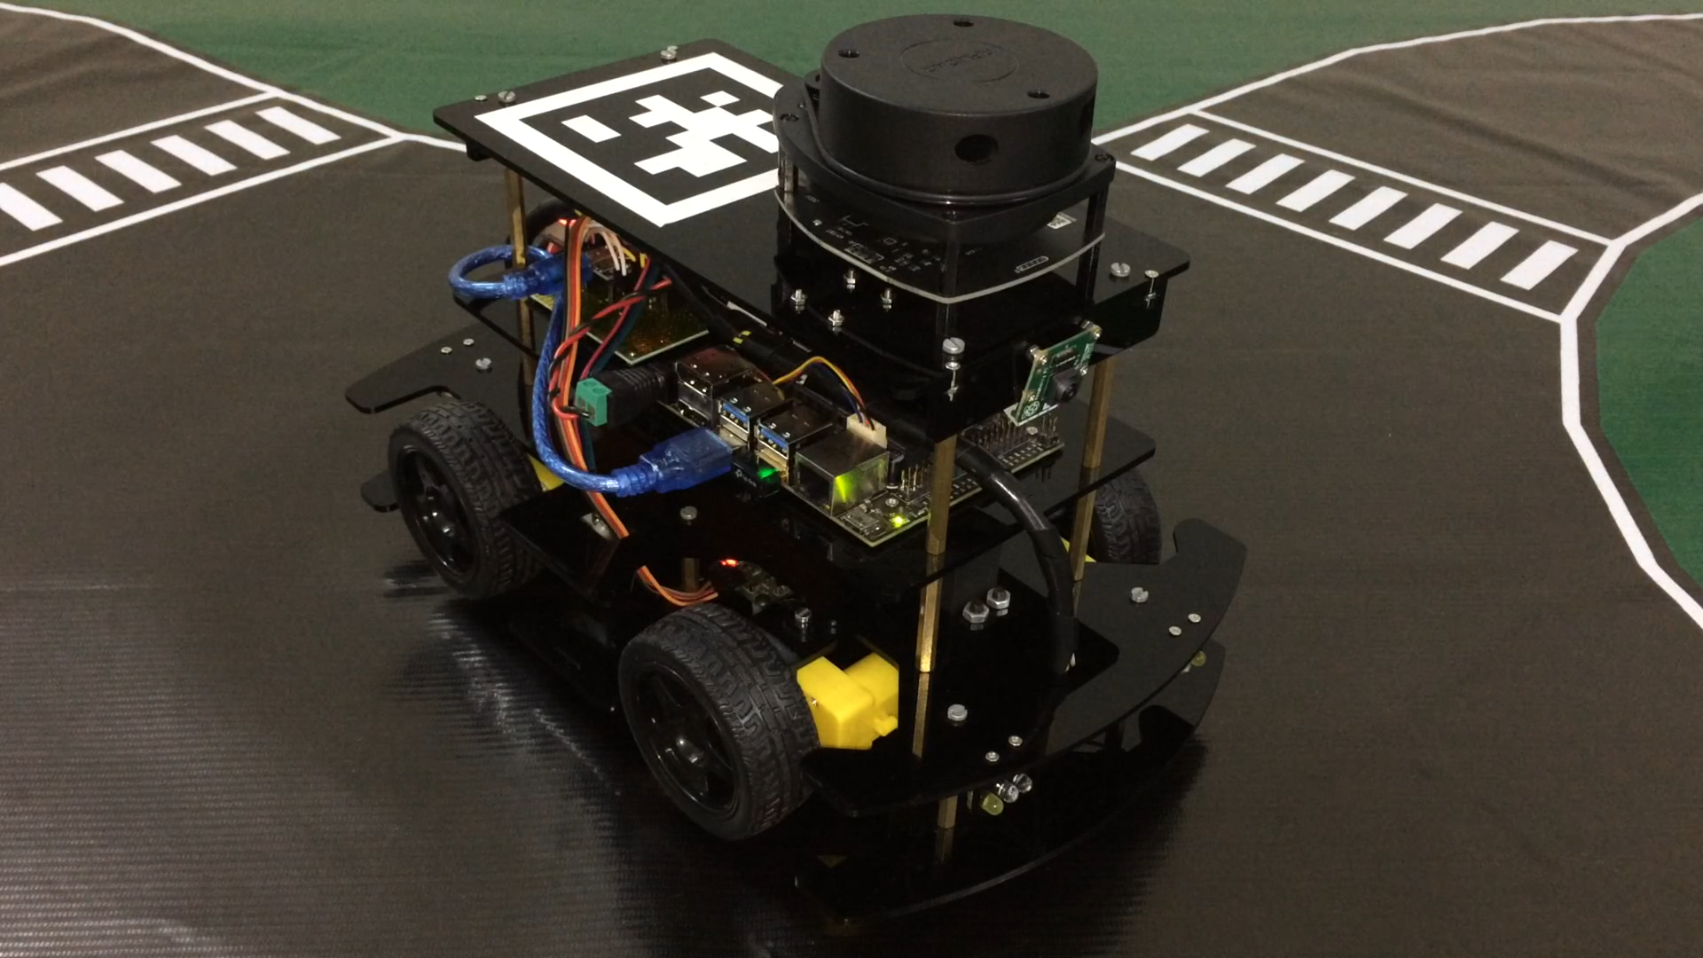
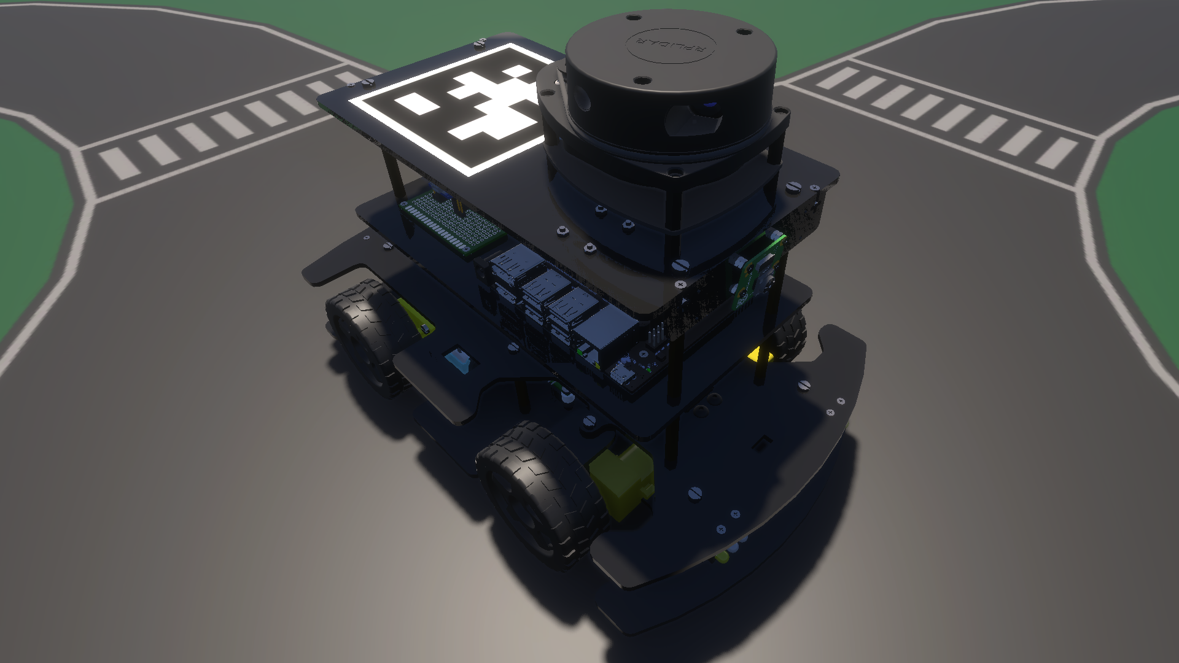
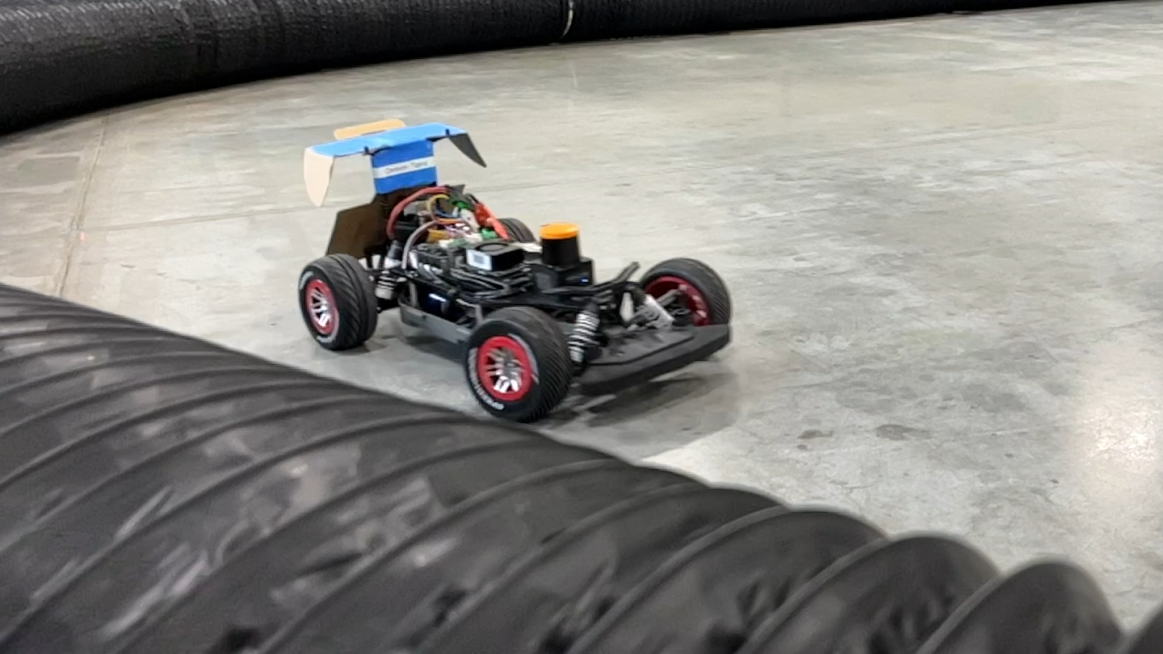
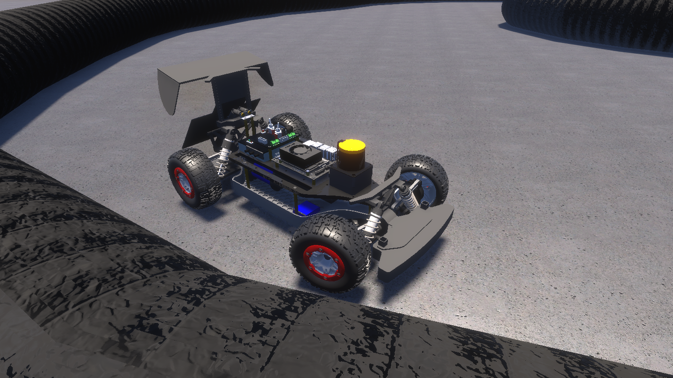
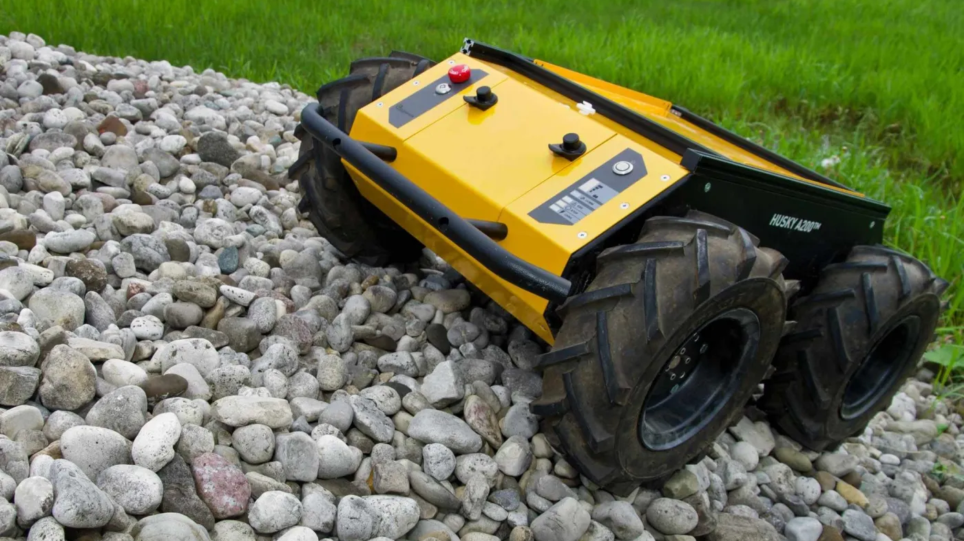
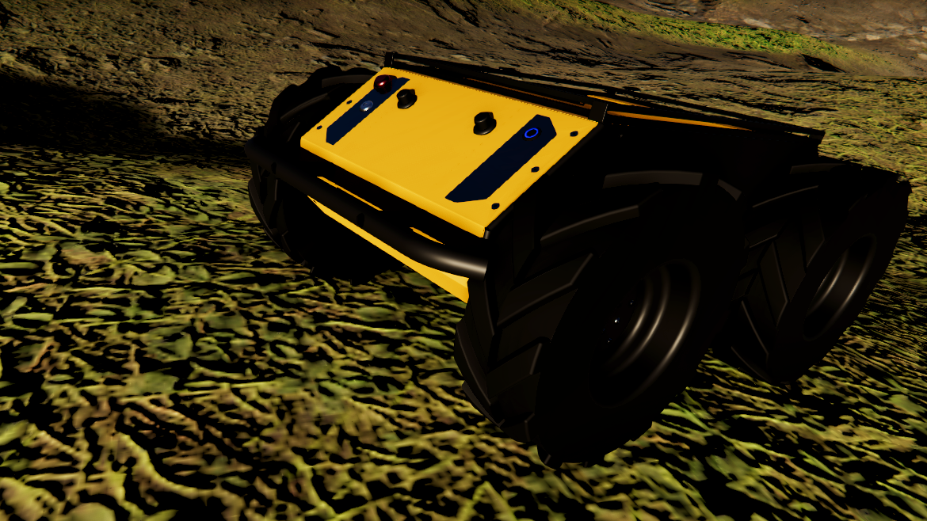
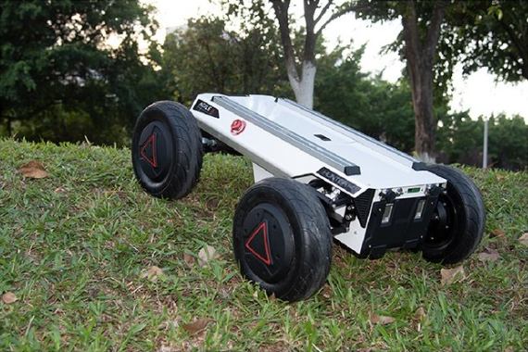
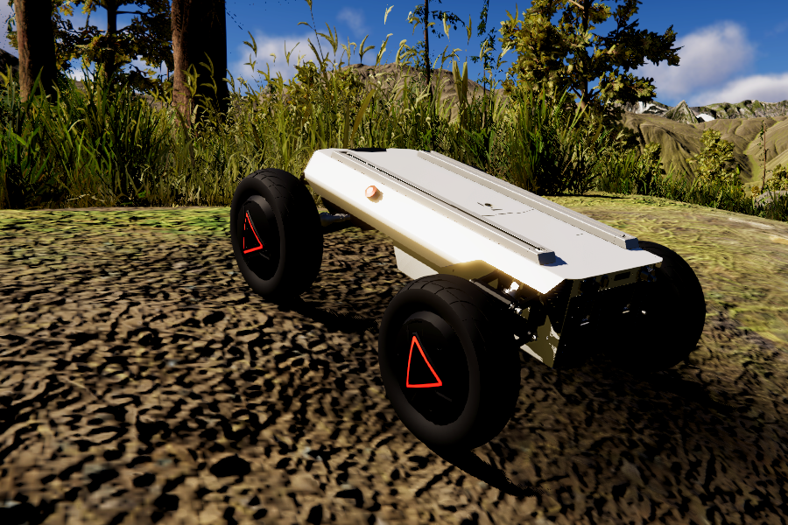
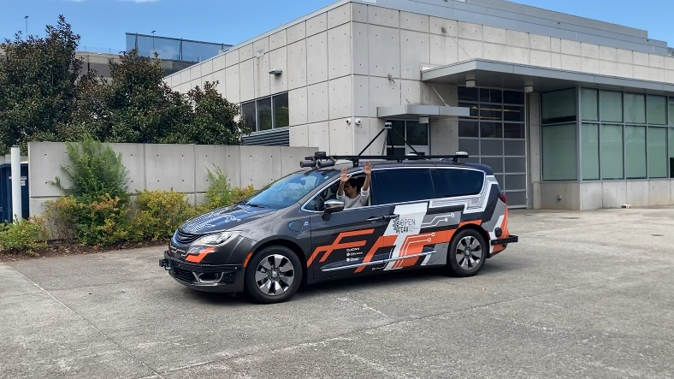
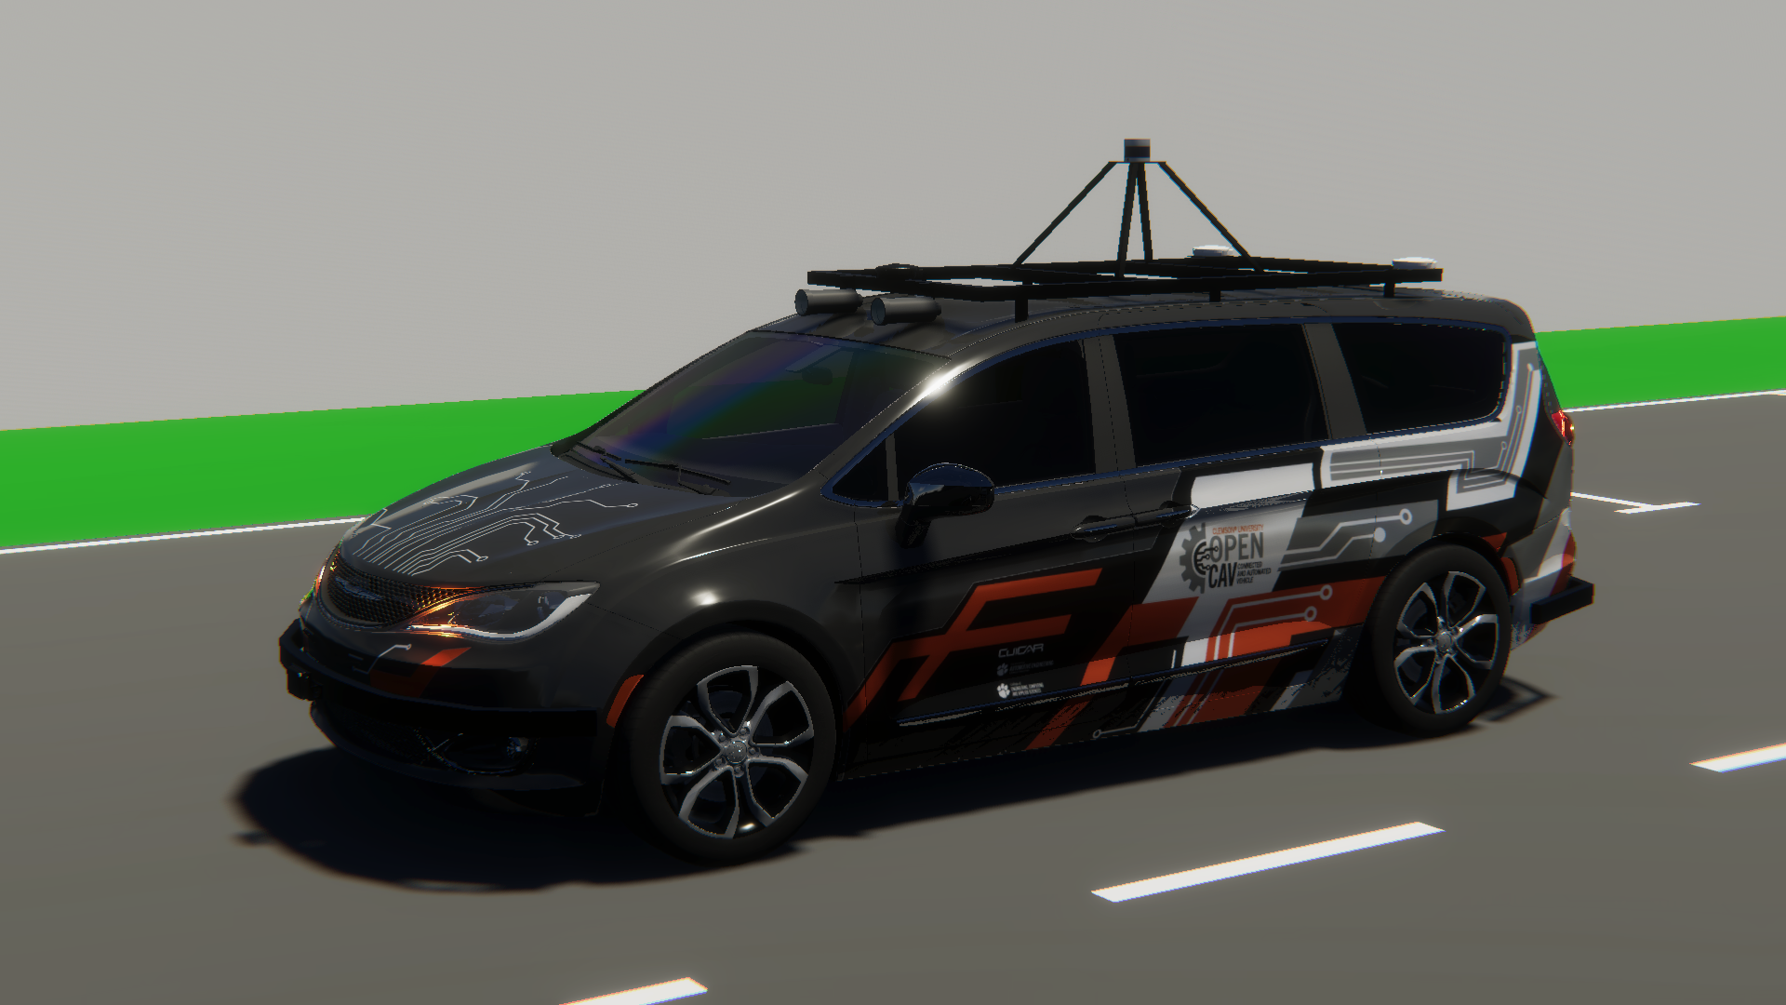
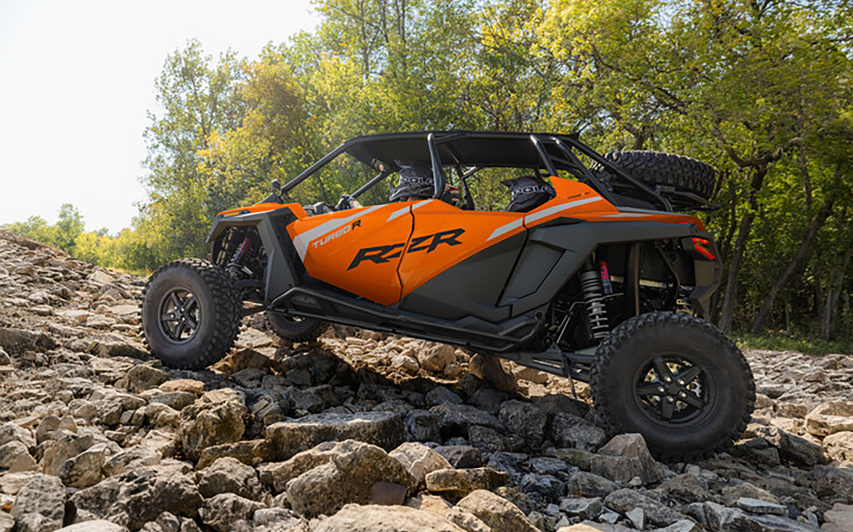
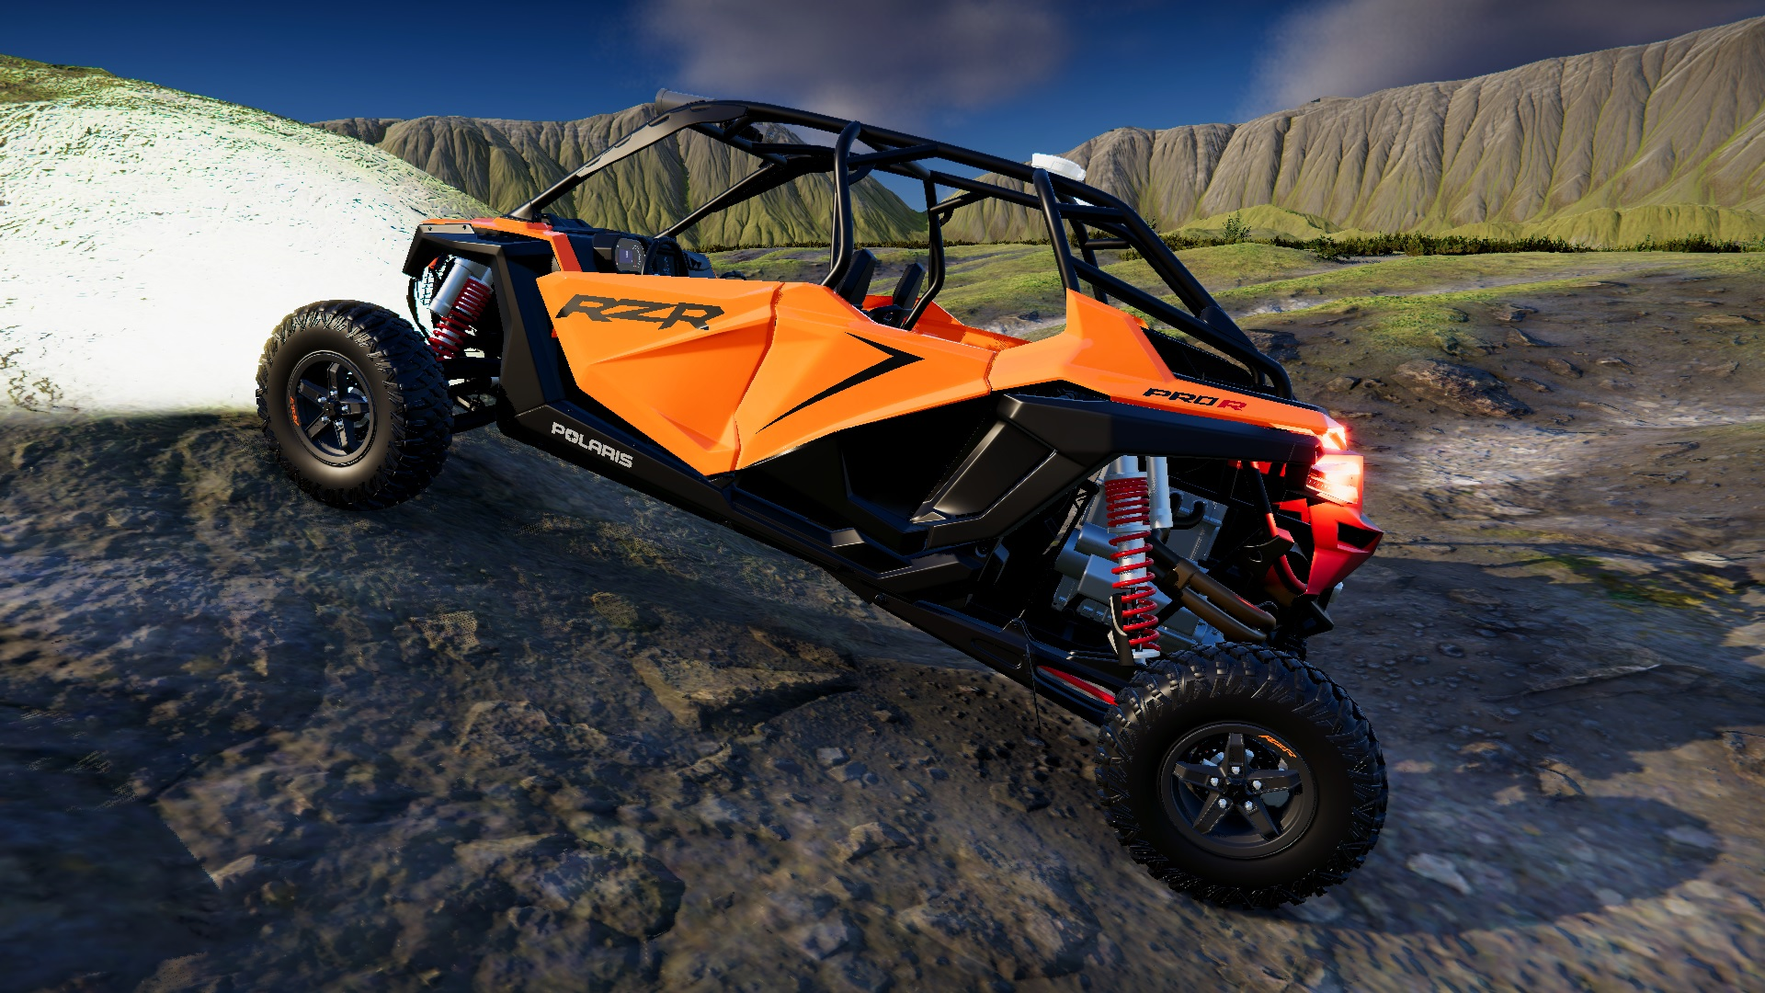
Vehicle Digital Twins in AutoDRIVE Ecosystem
SMALL-SCALE
Nigel (Native Vehicle)
F1TENTH (1/10th Scale Racecar)
MID-SCALE
Husky (On/Off-Road Skid-Steer Robot)
Hunter SE (On/Off-Road Ackermann Steered Vehicle)
FULL-SCALE
OpenCAV (On-Road Commercial Vehicle)
RZR (Recreational Off-Highway Vehicle)
Source: AutoDRIVE Ecosystem

Slide 5
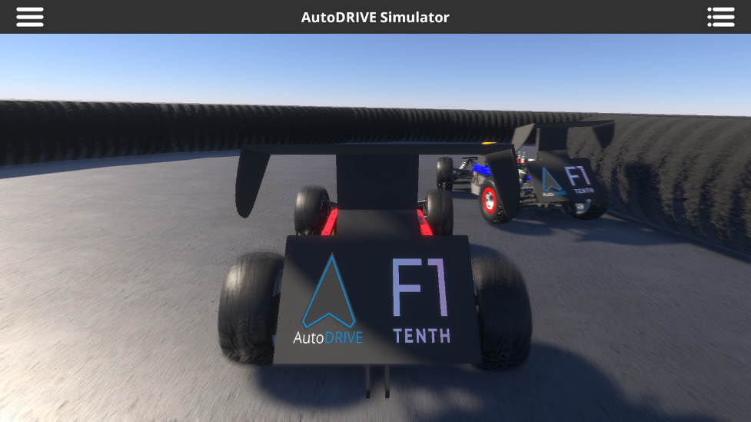
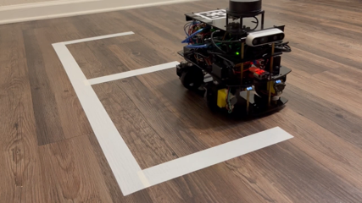
Small-Scale Vehicles
F1TENTH
Scaled autonomous racecar
AutoDRIVE-F1TENTH Simulator
Documentation
Nigel
Mechanical design
Electronic design
Firmware development
Build documentation
ROS 1 integration & testing
ROS 2 integration & testing
Autoware integration & testing

Slide 6
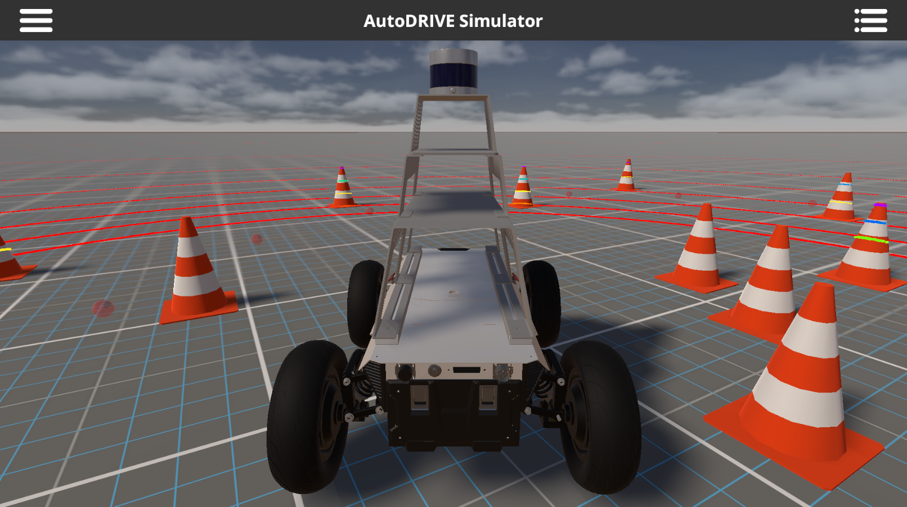
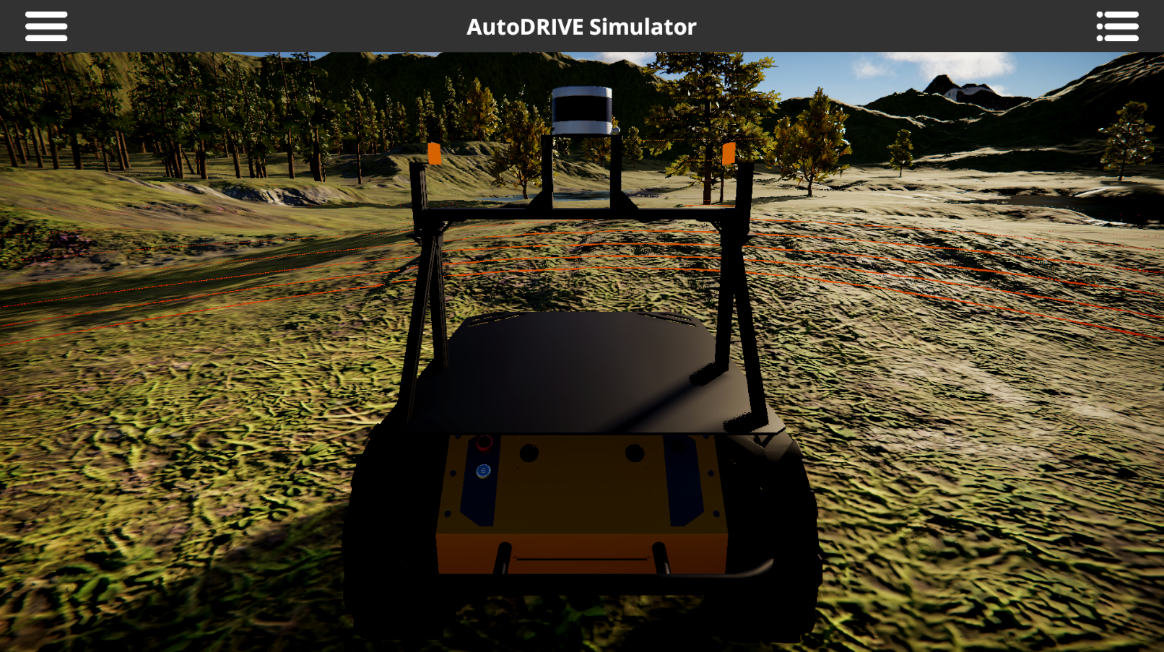
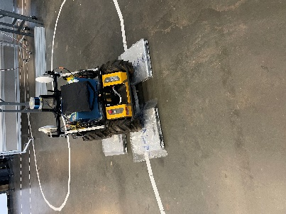
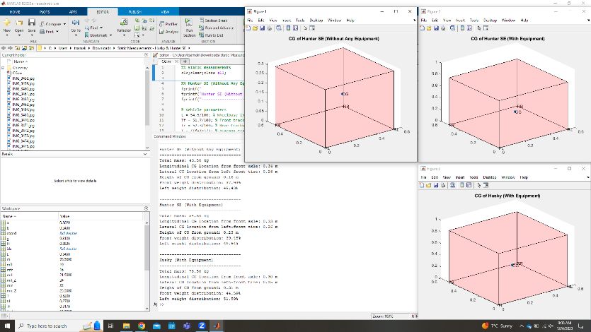
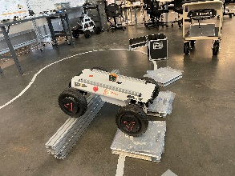
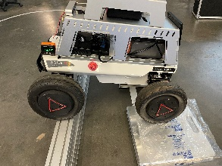
Mid-Scale Vehicles
Hunter SE
Static measurements & calibration
Geometric measurements & modelling
Simulation model (dynamics+ graphics)
API integration
Husky
Static measurements & calibration
Geometric measurements & modelling
Simulation model (dynamics+ graphics)
API integration

Slide 7
Full-Scale Vehicles
OpenCAV
Datasheet reference
Powertrain dynamics
Geometric measurements & modelling
Simulation model (dynamics+ graphics)
API integration
RZR
Datasheet reference
Powertrain dynamics
Simulation model (dynamics+ graphics)
API integration

Slide 8
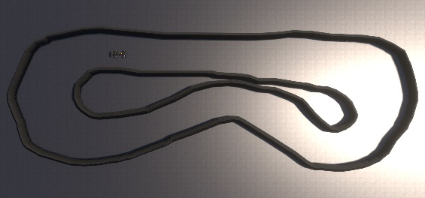
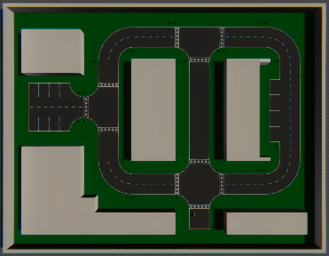
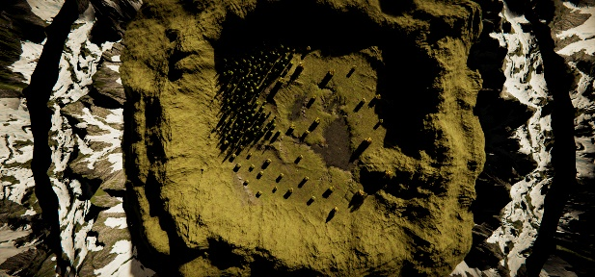
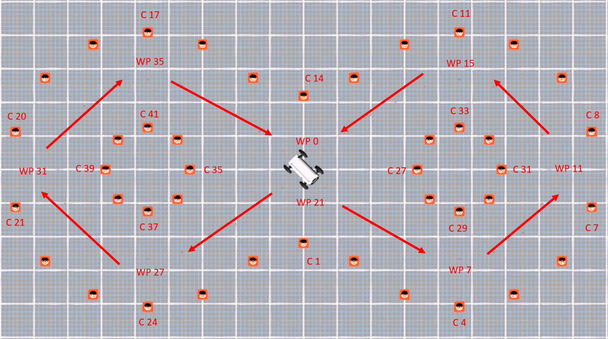
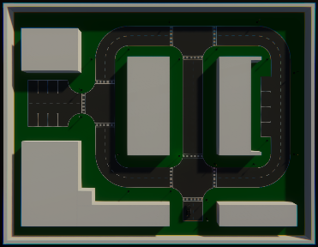
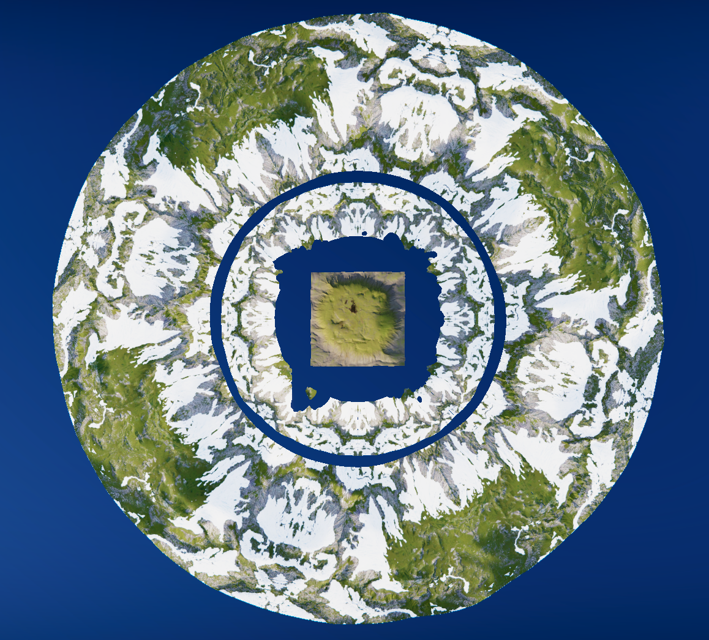
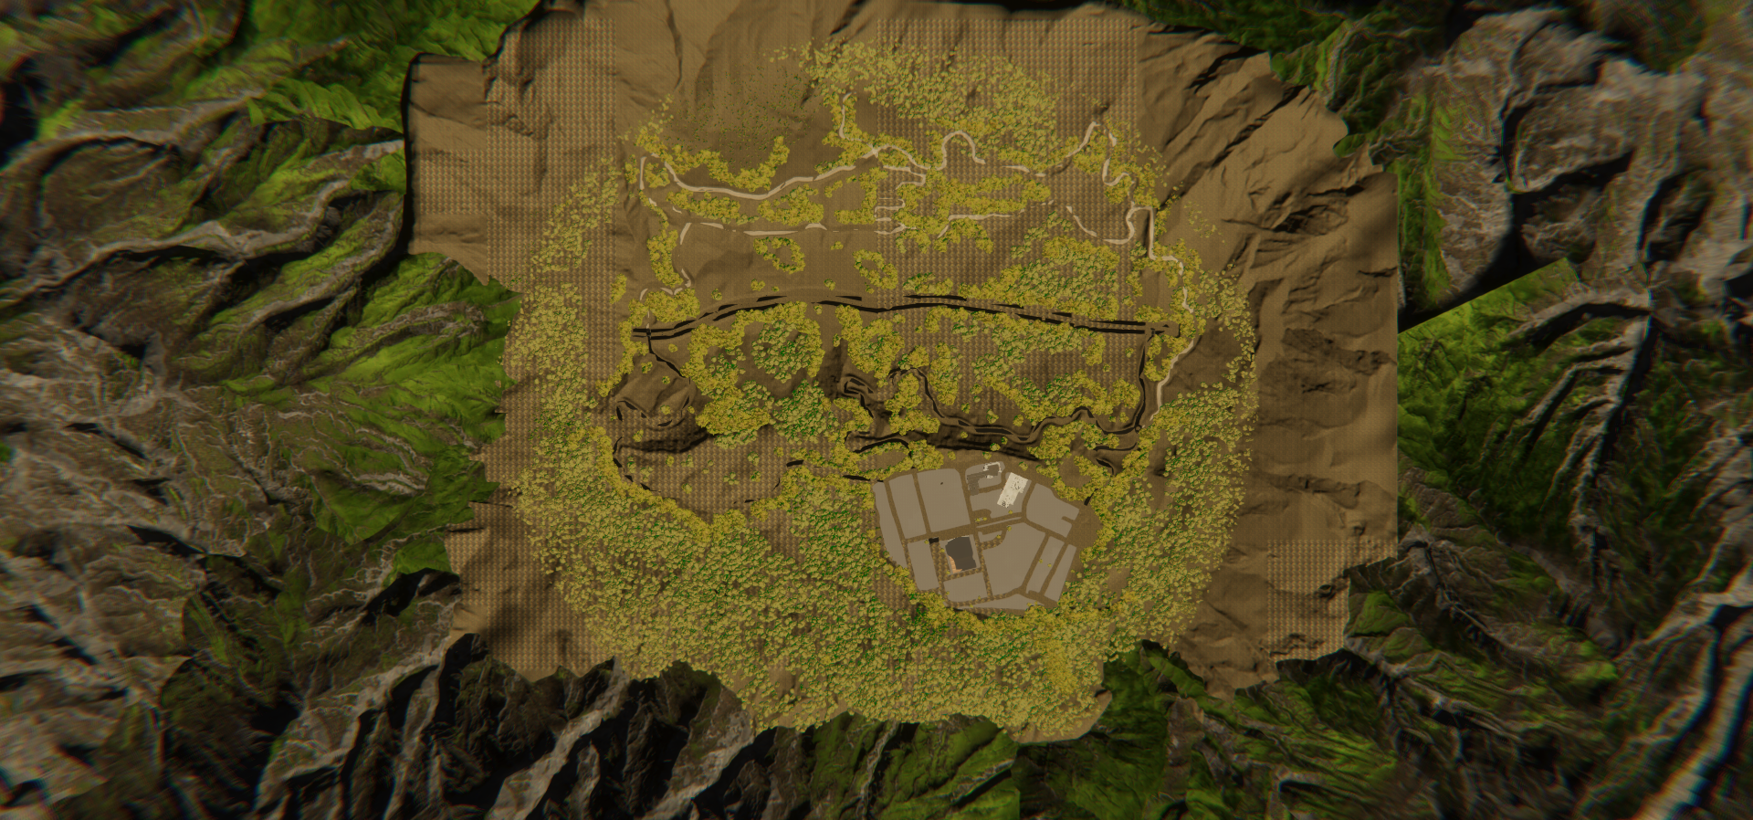
Environment Digital Twins in AutoDRIVE Ecosystem
SMALL-SCALE
Parking Lot
Eight Track
4-Way Intersection
Tiny Town
Porto Track
MID-SCALE
Tiny Town
Forest
Proving Ground
FULL-SCALE
Tiny Town
Forest
City
Source: AutoDRIVE Ecosystem

Slide 9
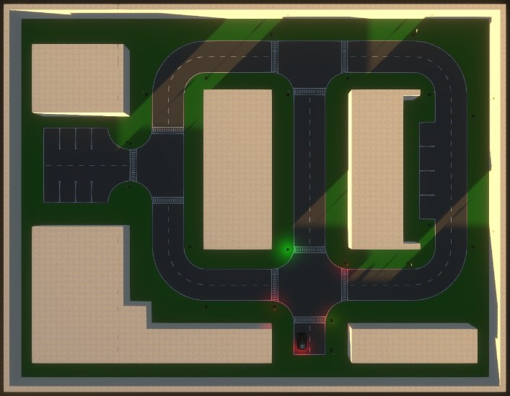
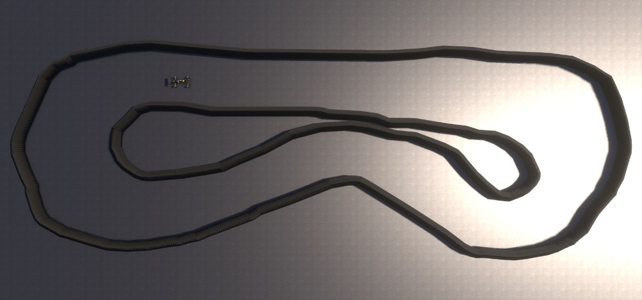
Small-Scale Scenarios
Tiny Town
Structured layout
Straights, left/right turns
3/4-way intersections
Roadside/lot parking
Porto Track
Closed racing circuit
Actual F1TENTH track
Straight, U-turns, bend
Lap timer

Slide 10

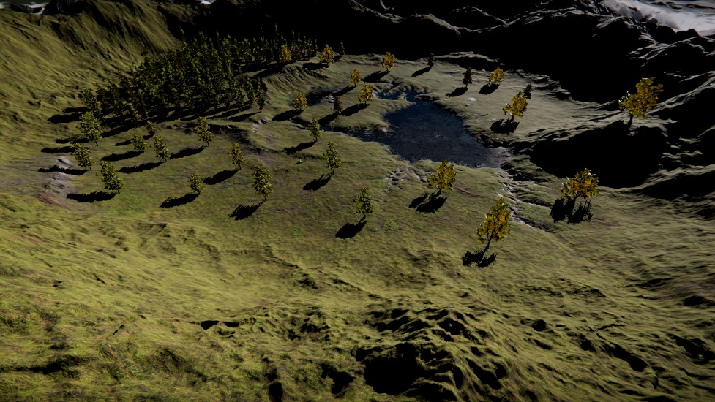
Mid-Scale Scenarios
Tiny Town
Structured layout
Straights, left/right turns
3/4-way intersections
Roadside/lot parking
Forest Scenario
Uneven terrain
Rough terrain heightmap
Textures (visual)
Obstructions
Soft vegetation (e.g. grass, shrubs)
Hard vegetation (e.g. trees)
Rocks and boulders
Mountains
Mountains at a distance
Smaller hillocks throughout
Water body
Lake at the center of the scene

Slide 11
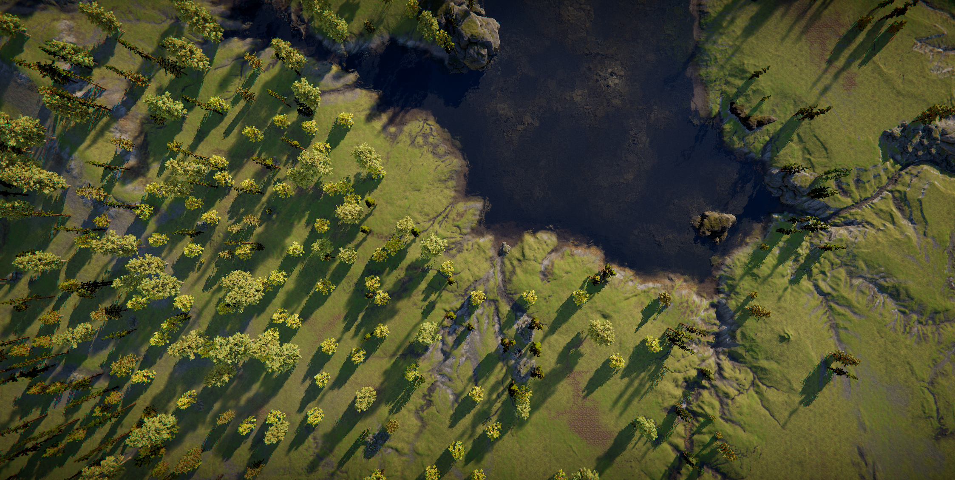
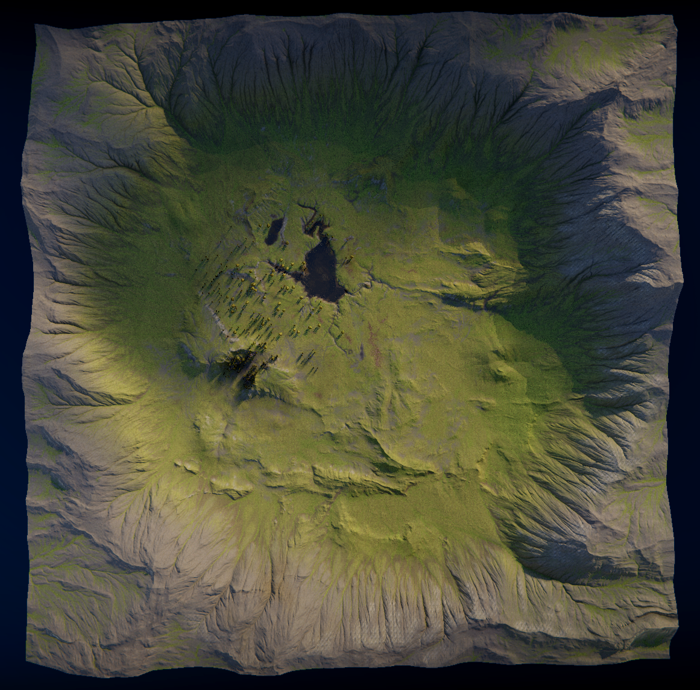
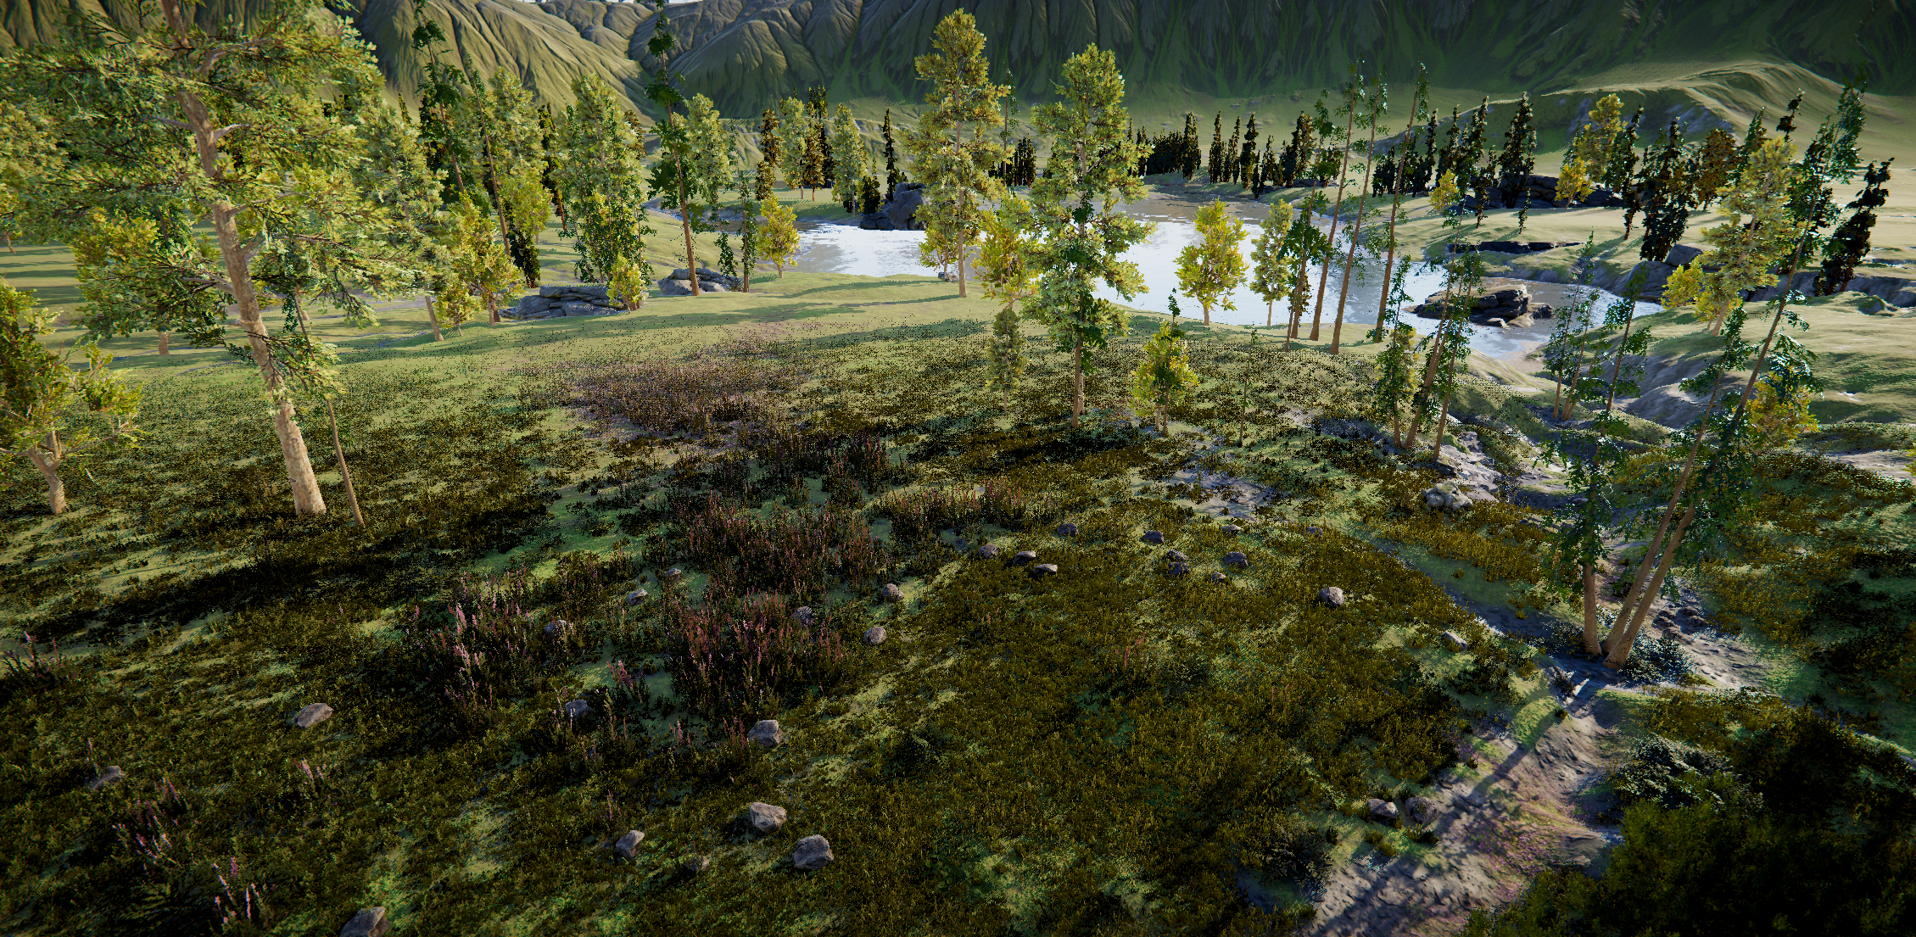
Full-Scale Scenarios
RZR
Forest scenario
OpenCAV
City scenario
LEGEND
Uneven terrain
Rough terrain heightmap
Textures (visual)
Obstructions
Soft vegetation (e.g. grass, shrubs)
Hard vegetation (e.g. trees)
Rocks and boulders
Mountains
Mountains at a distance
Smaller hillocks throughout
Water body
Lake at the center of the scene

Slide 12
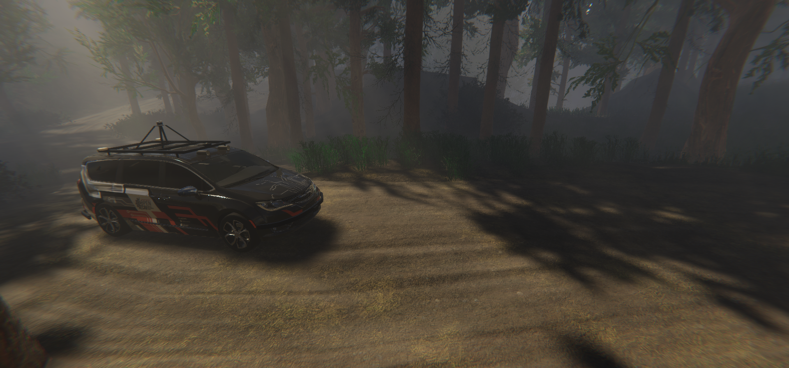
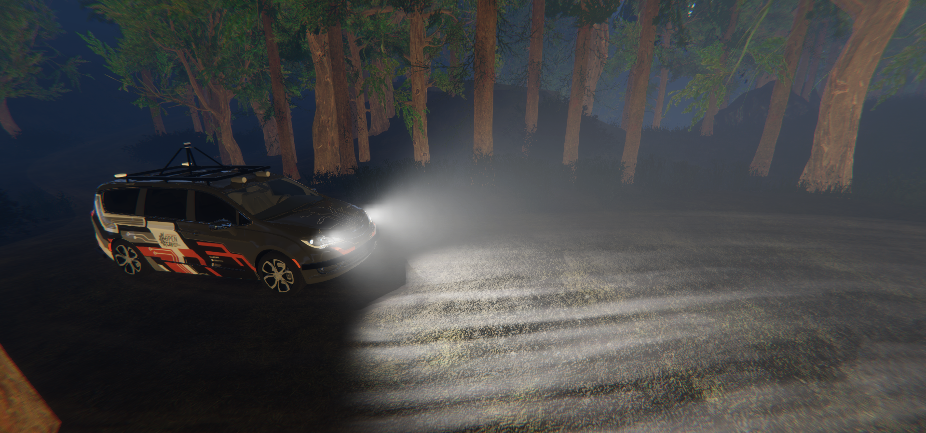
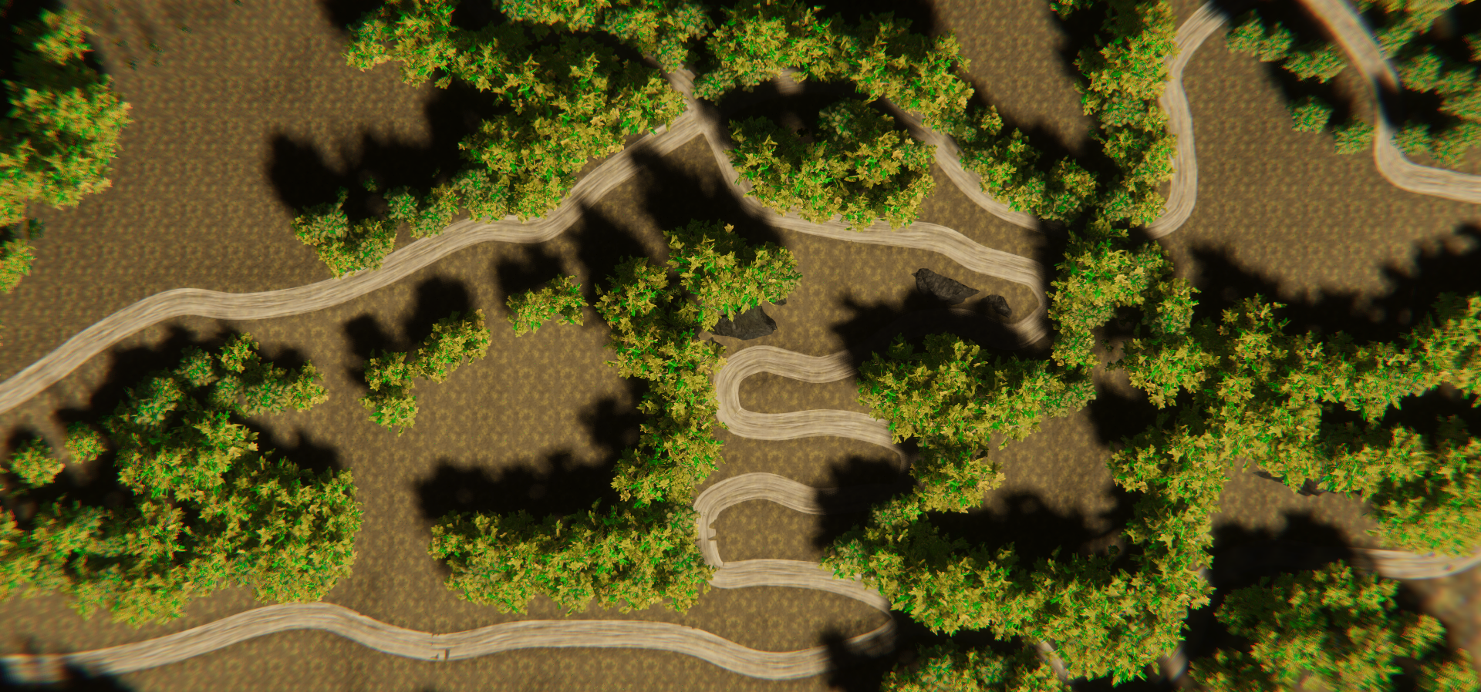
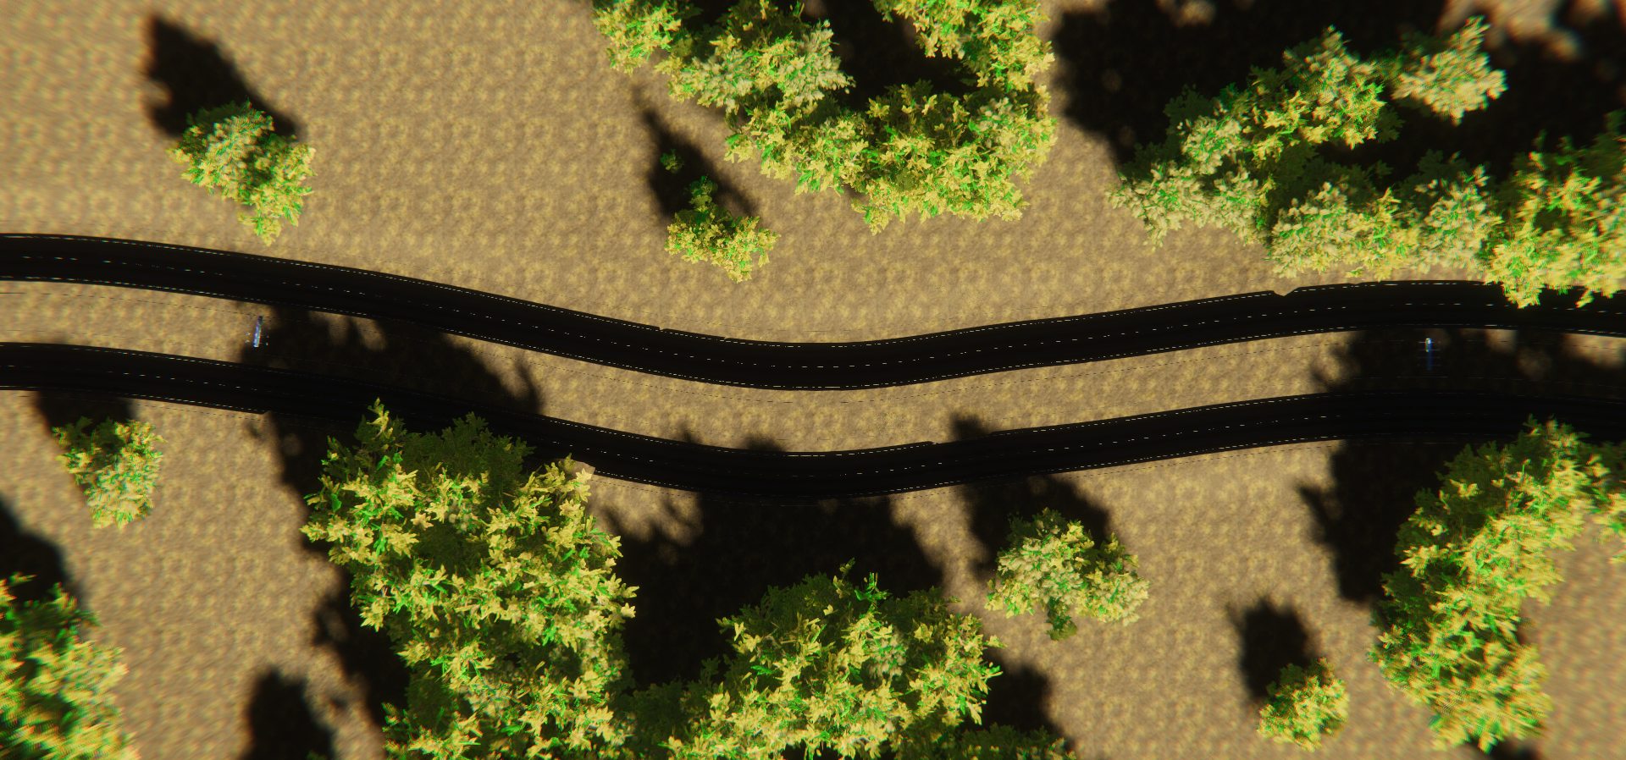
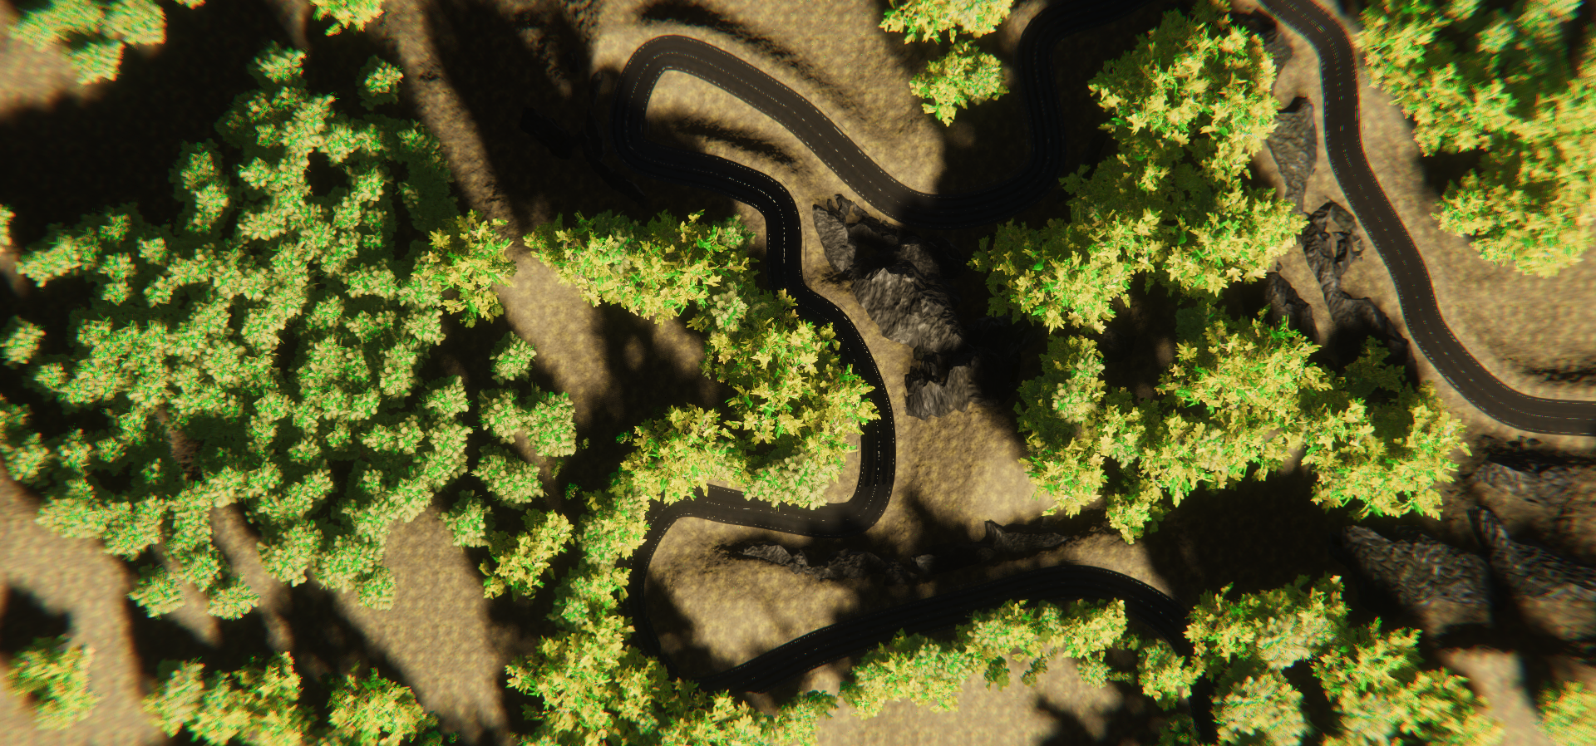
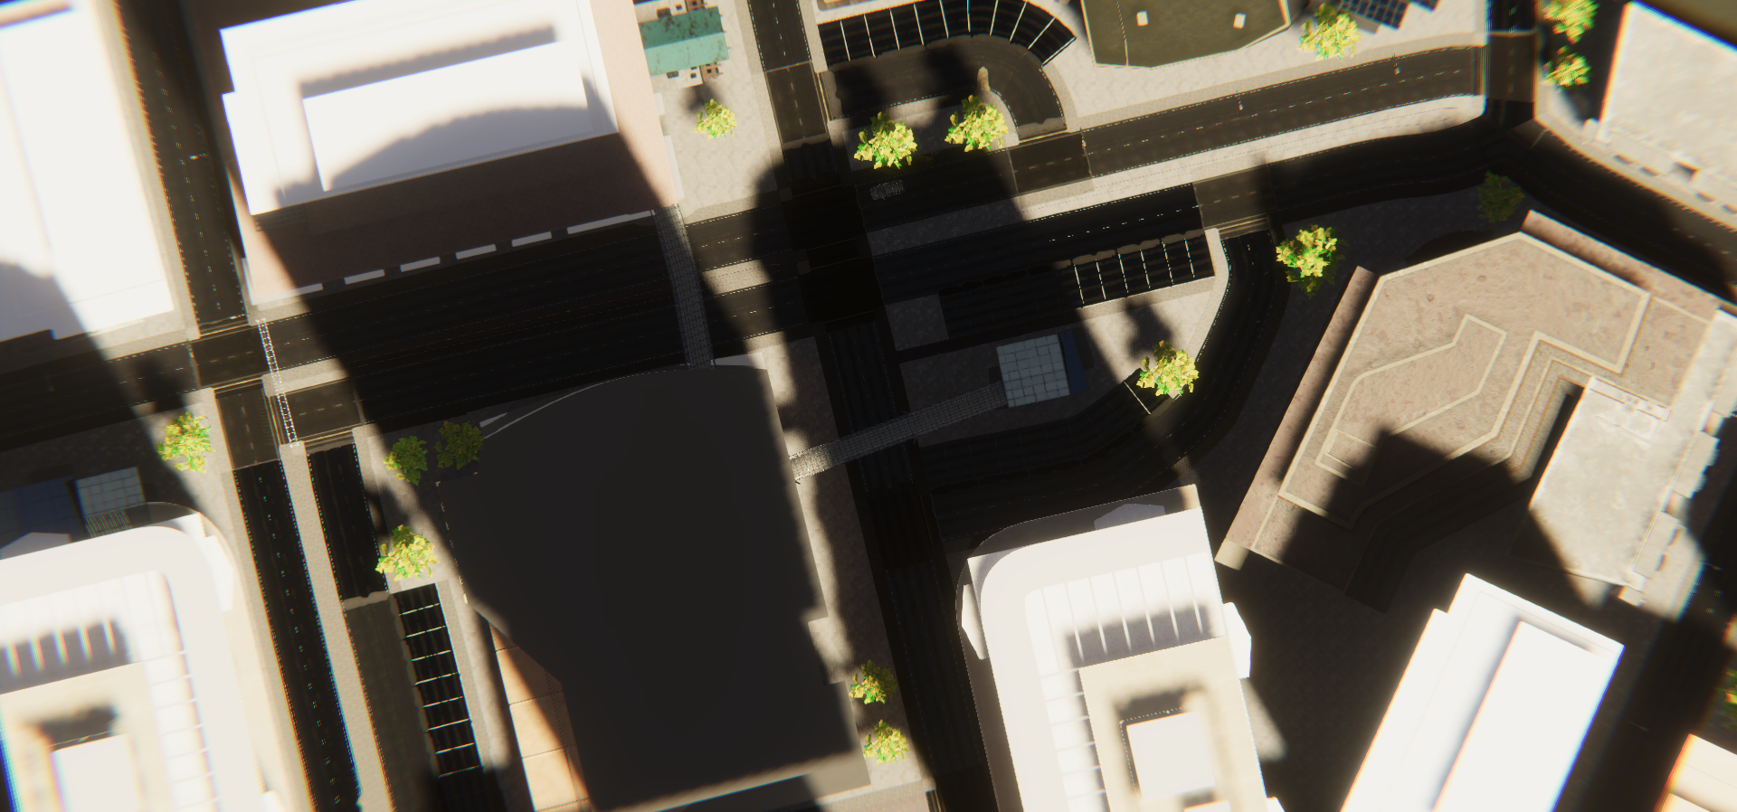
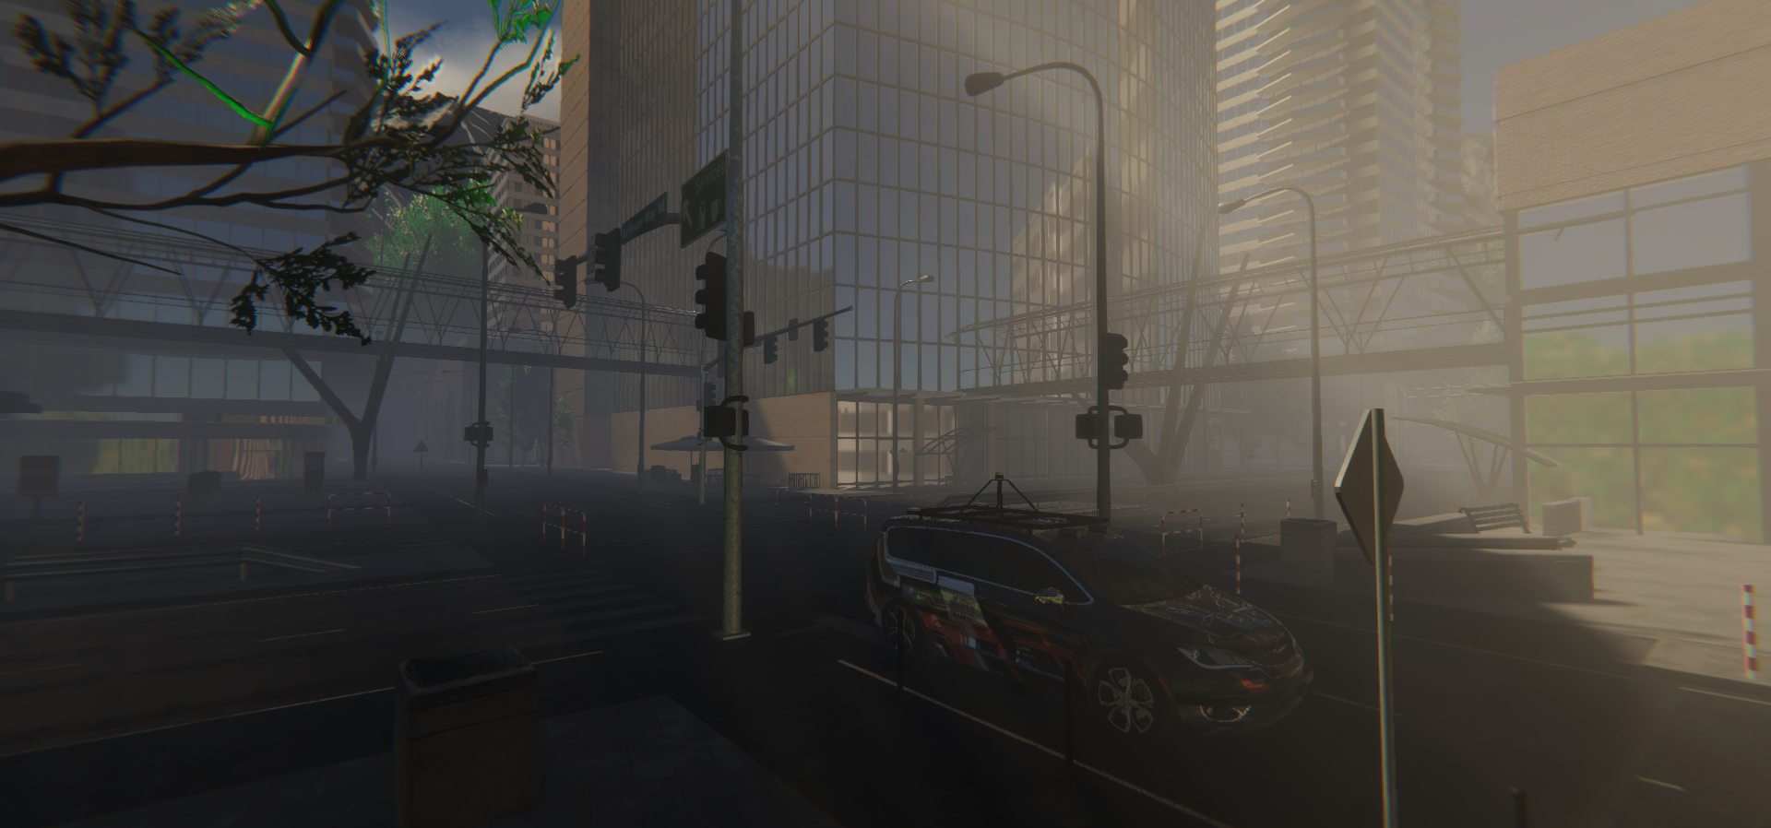
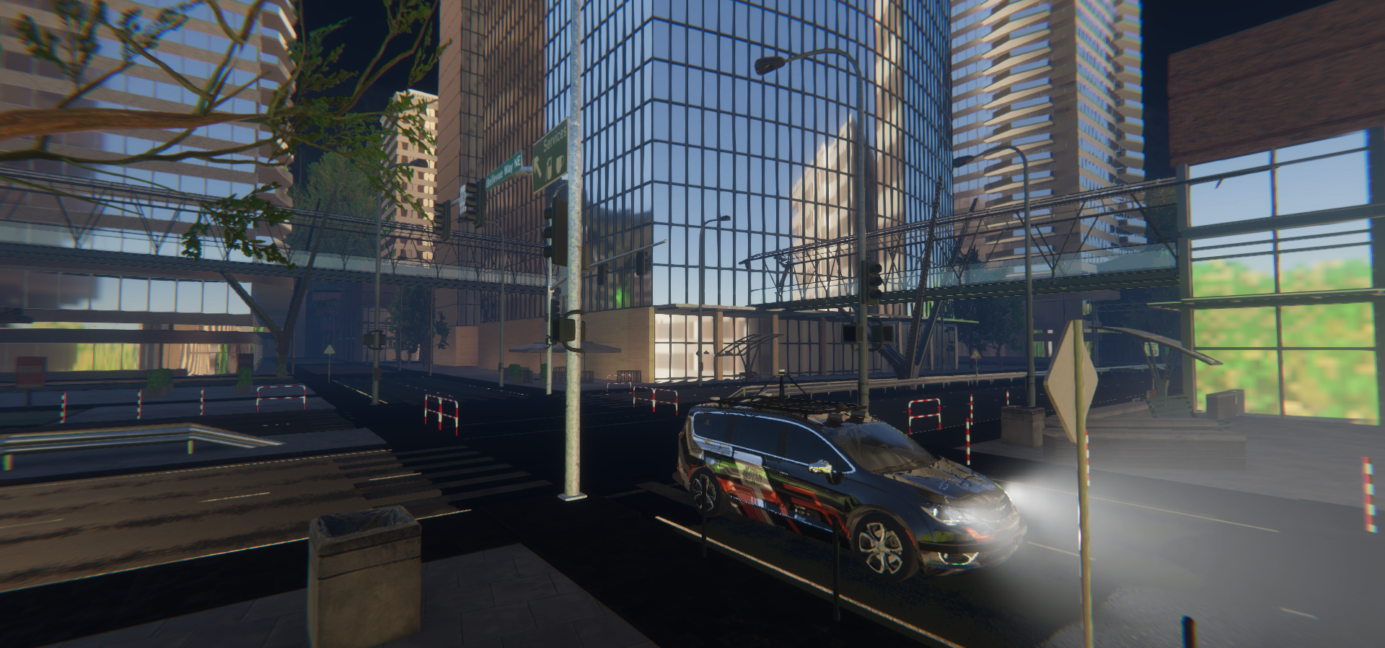
Full-Scale Scenarios
RZR
Forest scenario
OpenCAV
City scenario
Dirt Road
Highway
Mountain Pass
Downtown

Slide 13
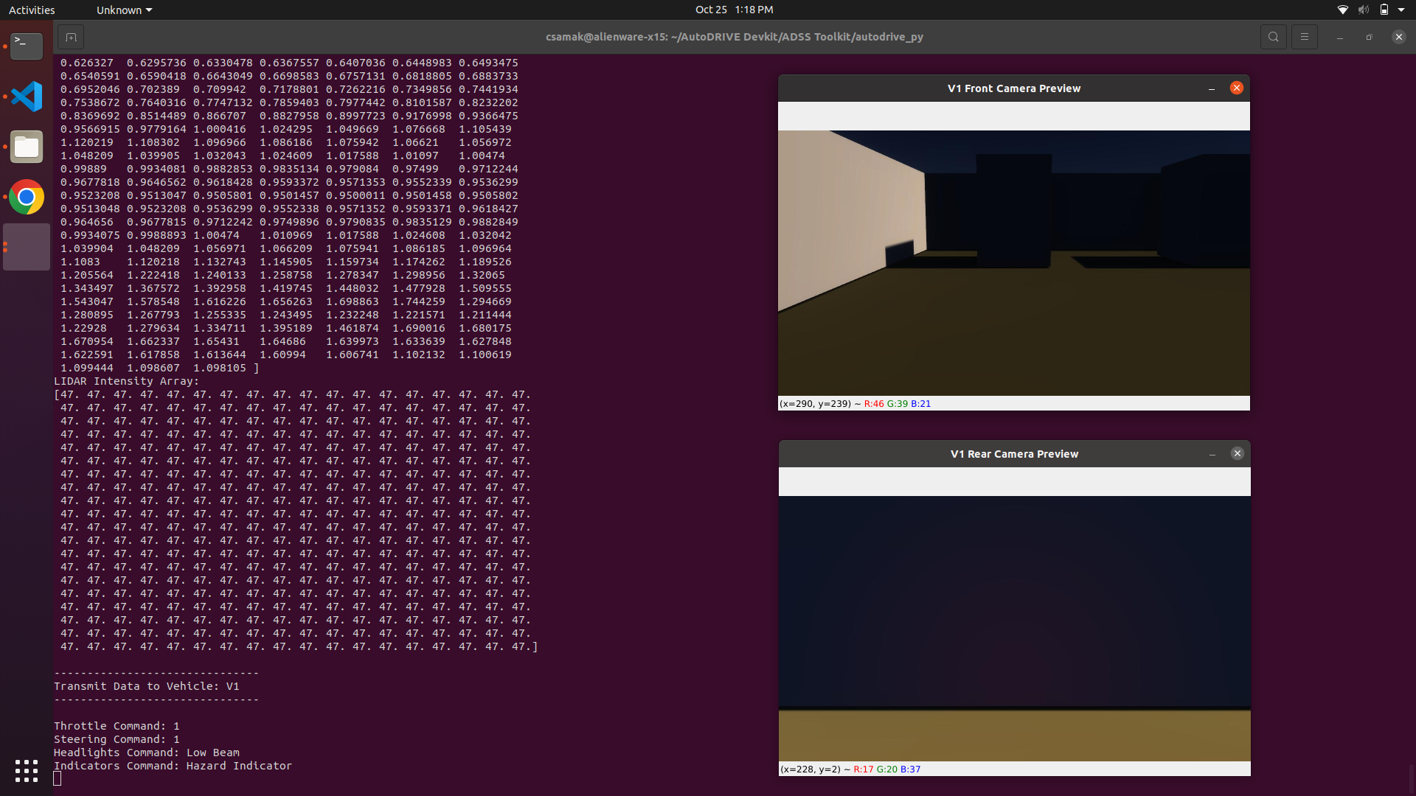
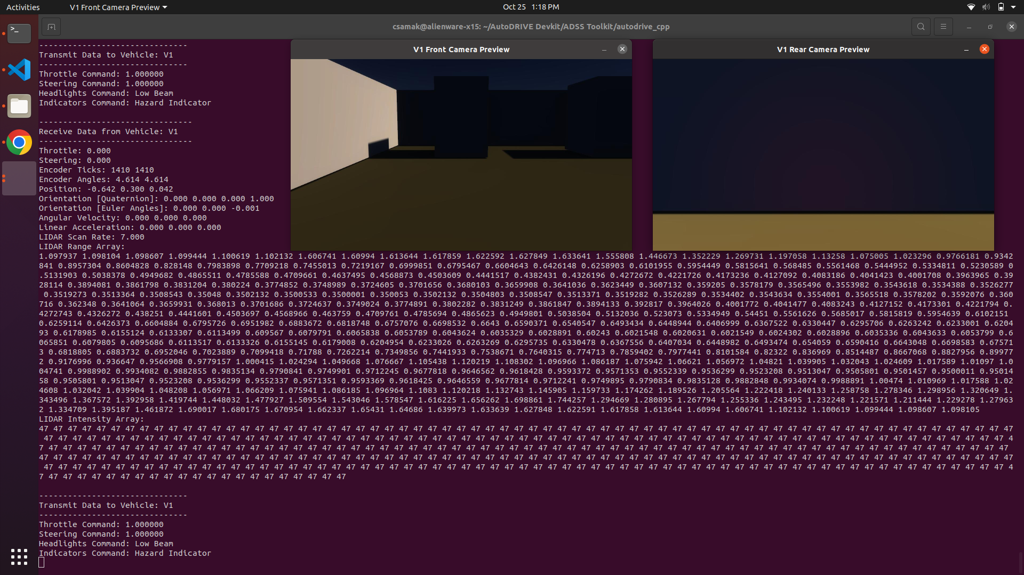
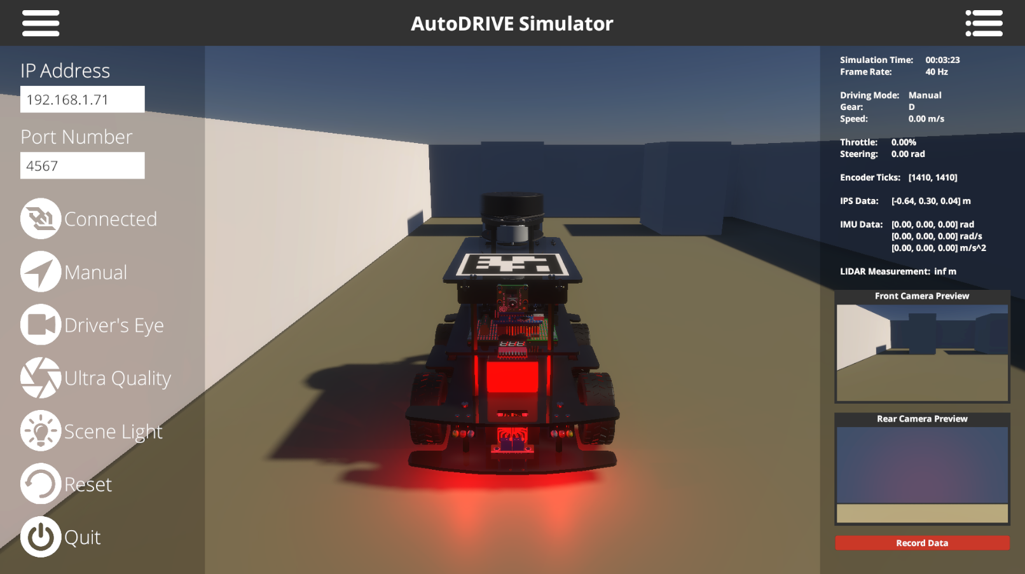


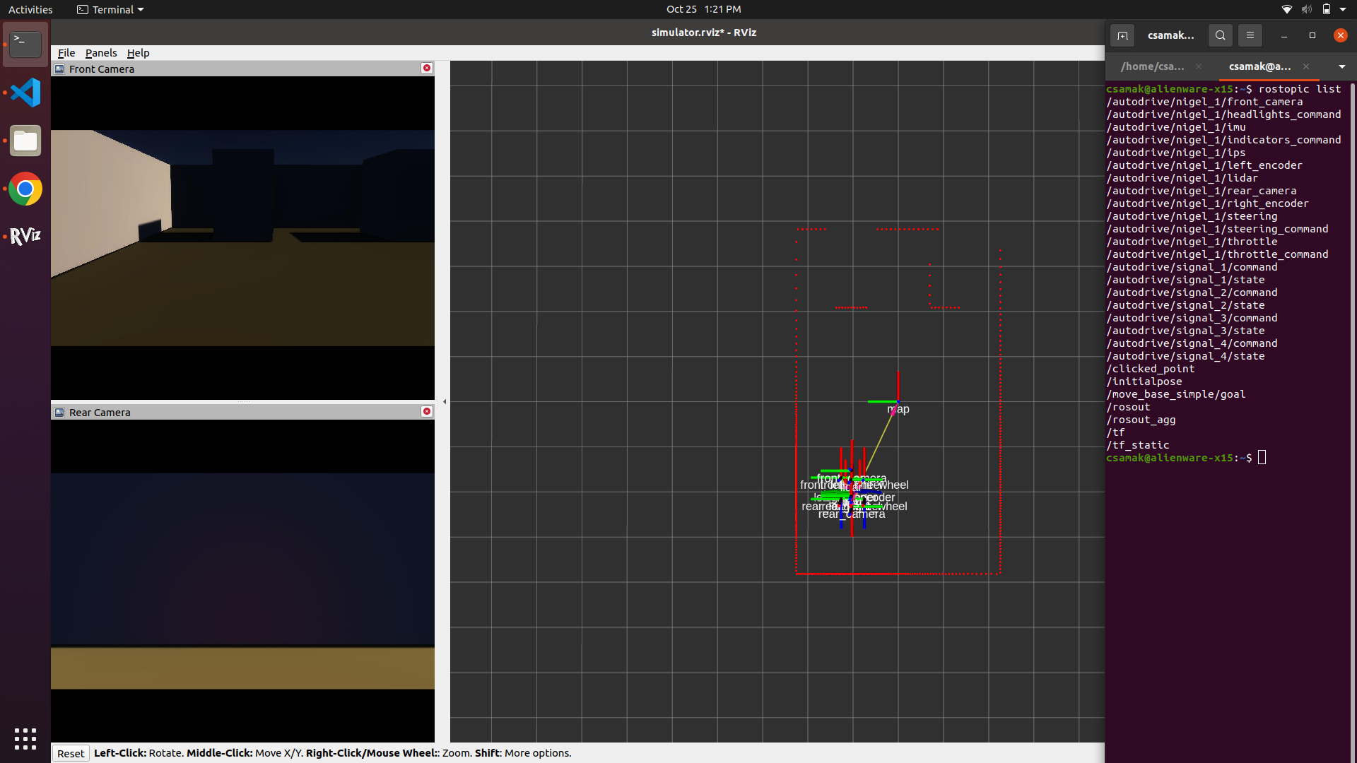
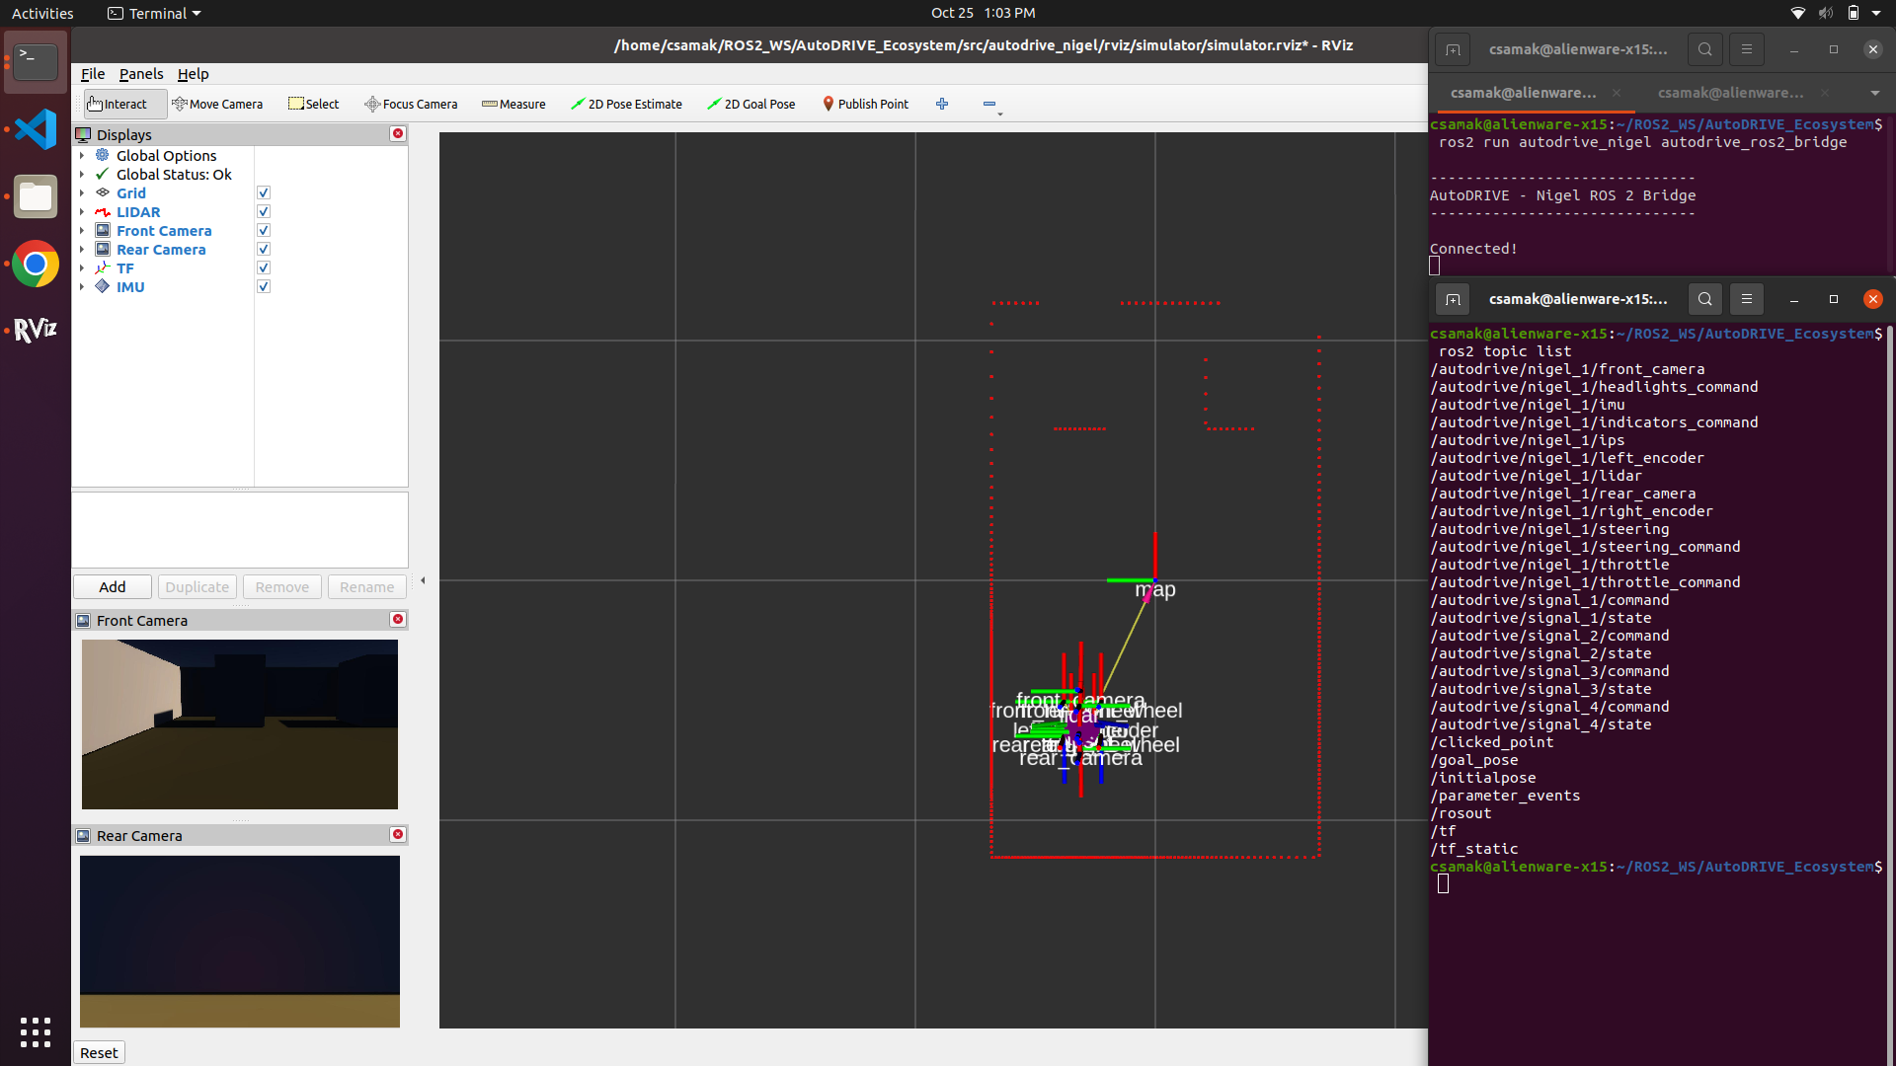


APIs to Connect with AutoDRIVE Ecosystem
Python
C++
AutoDRIVE
ROS
ROS 2

Slide 14
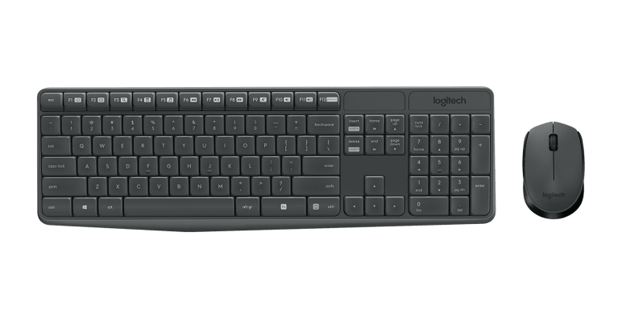
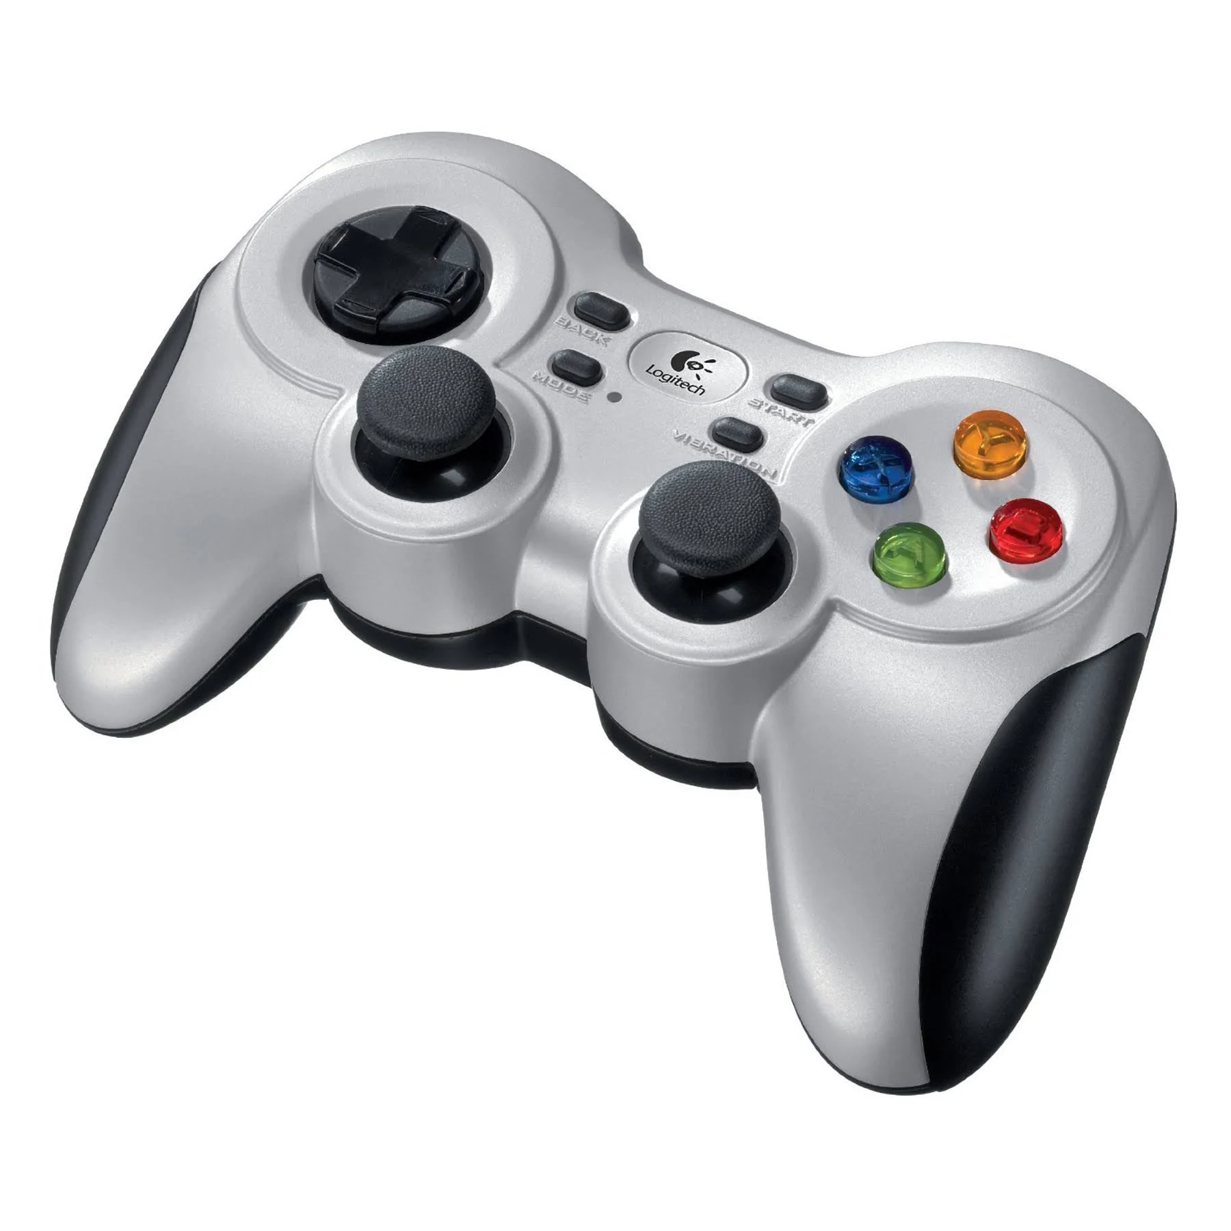
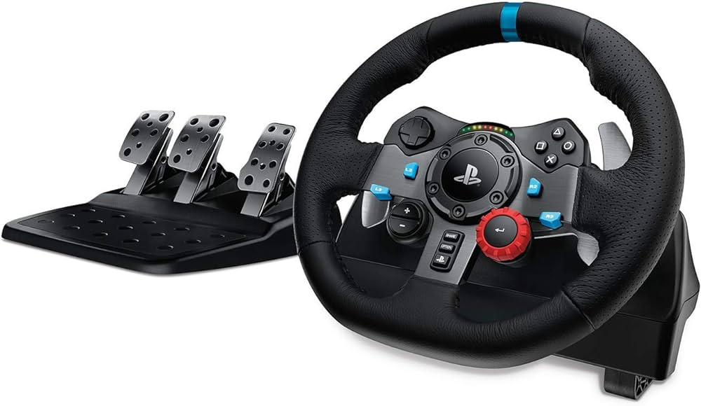

HMIs to Connect with AutoDRIVE Ecosystem
AutoDRIVE
Keyboard+Mouse
Gamepad
Driving Rig
Direct HMI vs. API-Mediated HMI

Slide 15
References
T. Samak, C. Samak, S. Kandhasamy, V. Krovi, and M. Xie, “AutoDRIVE: A Comprehensive, Flexible and Integrated Digital Twin Ecosystem for Autonomous Driving Research & Education,” Robotics, vol. 12, no. 3, p. 77, May 2023, doi: 10.3390/robotics12030077
W. Ding, C. Xu, M. Arief, H. Lin, B. Li and D. Zhao, “A Survey on Safety-Critical Driving Scenario Generation—A Methodological Perspective,” in IEEE Transactions on Intelligent Transportation Systems, vol. 24, no. 7, pp. 6971-6988, July 2023, doi: 10.1109/TITS.2023.3259322
M. Quigley, K. Conley, B. Gerkey, J. Faust, T. Foote, J. Leibs, R. Wheeler, and A. Ng, “ROS: an open-source Robot Operating System,” in ICRA 2009 Workshop on Open Source Software, vol. 3, Jan 2009. [Online]. Available: http://robotics.stanford.edu/~ang/papers/icraoss09-ROS.pdf
S. Macenski, T. Foote, B. Gerkey, C. Lalancette, and W. Woodall, “Robot operating system 2: Design, architecture, and uses in the wild,” Science Robotics, vol. 7, no. 66, p. eabm6074, 2022. [Online]. Available: https://www.science.org/doi/abs/10.1126/scirobotics.abm6074
Autoware Foundation, “Autoware Project: The world’s leading open-source software project for autonomous driving.” [Online]. Available: https://autoware.org

Slide 16
Thank You!
…Open to questions and discussion.

